Slide 1
CS-8803 MGMT & Leadership
Lab to Venture Capital - Bridging the Innovation Gap Initiative
Amr Arafa

Slide 2
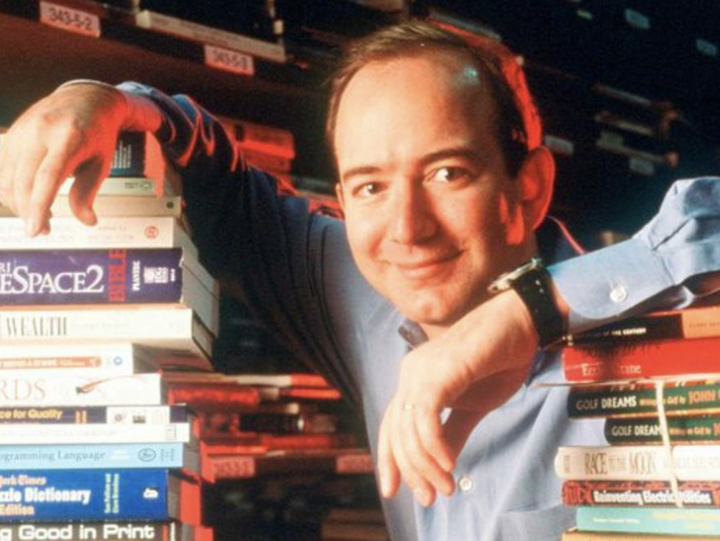
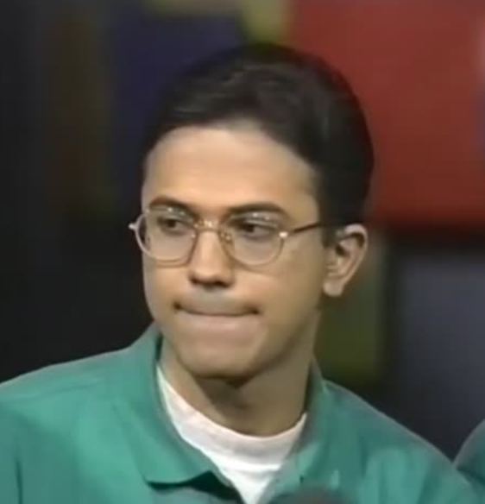
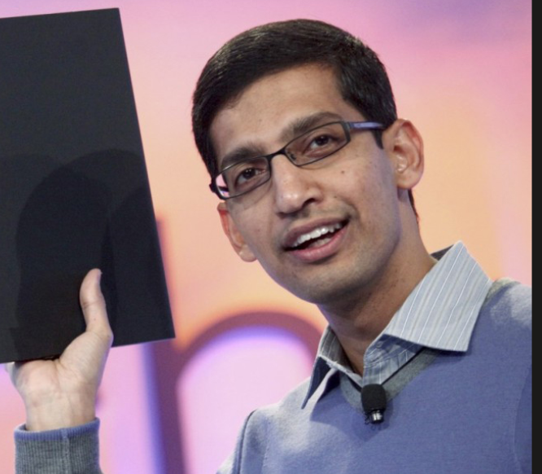
Software Leaders
Jeff Bezos
Former CEO of Amazon /Former Product Manager (Bankers Trust)
Embedded the PM mindset into Amazon by inventing the famous "Working Backwards" (PR/FAQ) product framework.
Satya Nadella
CEO of Microsoft /Former Product Manager
Started as a Product Manager and spearheaded the company's massive pivot to the Azure cloud platform.
Sundar Pichai
CEO of Google /Former Product Manager
Joined as a Product Manager and built his leadership reputation by launching Google Chrome.

Slide 3
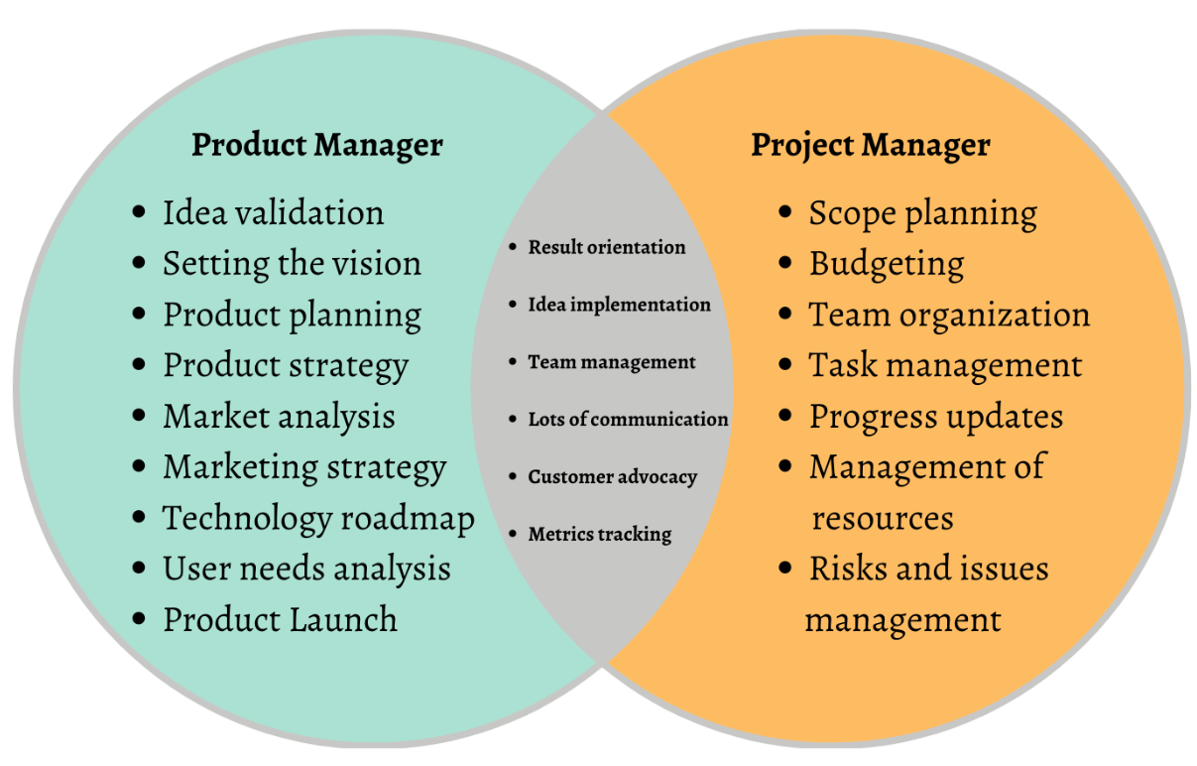

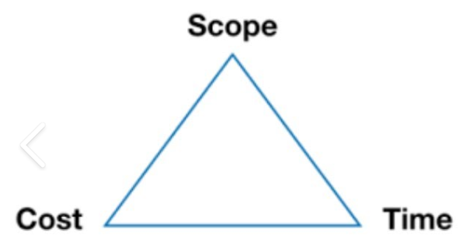
Product Management VS Project Management
Let’s not:
Go Over Budget
Miss Deadlines
Miss Scope
Let’s not:
Deliver a “solution looking for a problem to solve”

Slide 4
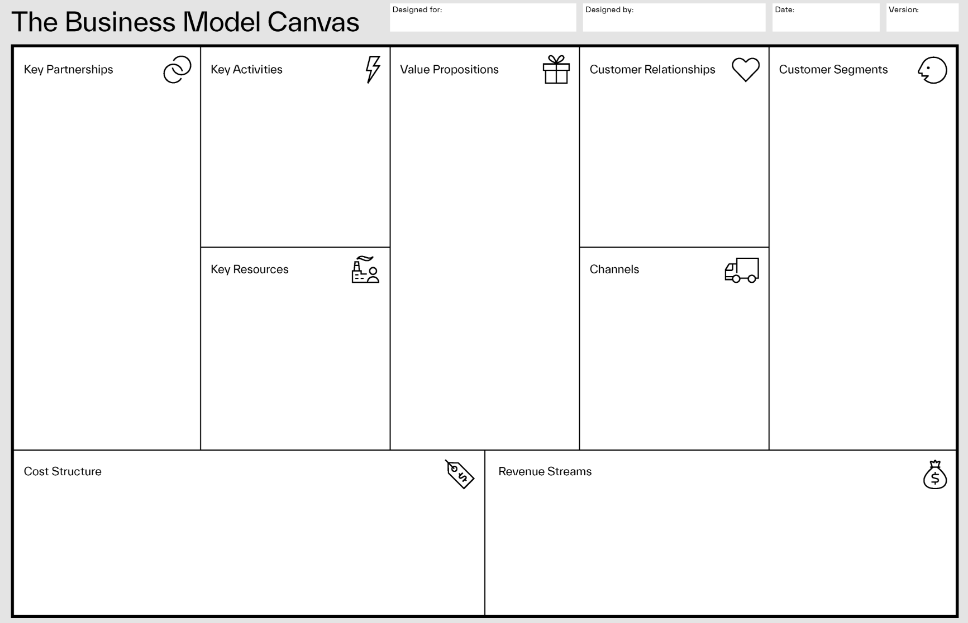

Slide 5

Discovery VS Commercial Viability
The gap between groundbreaking academic research and commercial viability is referred to as the "Valley of Death“.
Annually, universities pour nearly $90 billion into R&D, yet fewer than 10% of patented academic discoveries transition into commercialized products.
Commercialized research benefits Researchers ($$$), the Universities (ROI), and Society (solving real problems).
Google: Researchers ($100B), Stanford ($336M), Society (Organizing the world’s information)
BioNTech / Moderna: Researchers (~$100M+), University of Pennsylvania ($1.2B), Society (Saving lives i.e.COVID-19 vaccines)
Gatorade: Researchers ($250M+), University of Florida ($1B+), Society (Invented modern sports hydration)

Slide 6
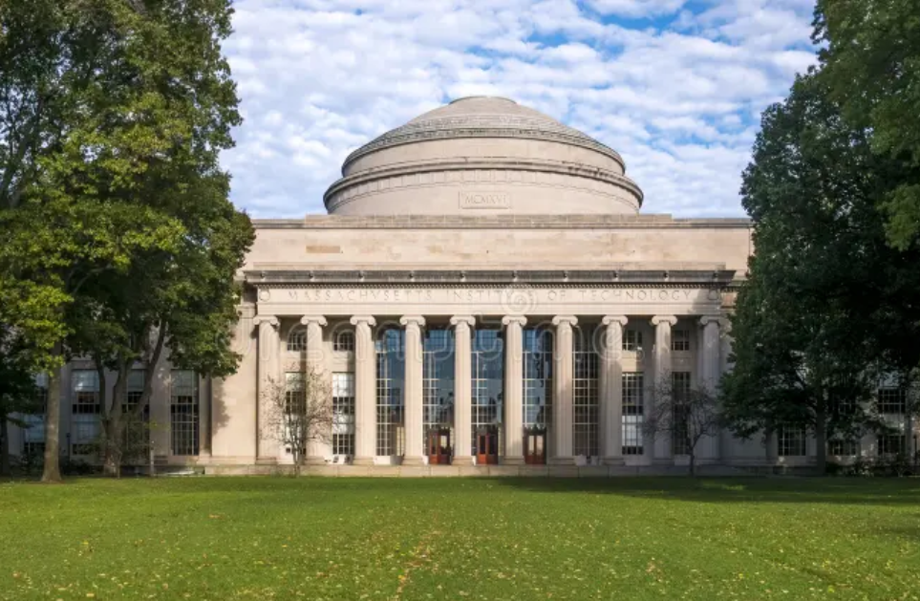
The MIT Example
Top-tier research institutions do not leave commercialization to chance or rely on administrative serendipity.
They treat it as a rigorous, standardized pipeline.
Massachusetts Institute of Technology (MIT) Spins out over 25-30 robust companies annually.
The Impact: Generates an estimated $2 trillion in global annual revenue from active alumni companies.

Slide 7
The Root Cause: It is rarely a lack of technical merit; it is a failure in commercial translation.
Venture capitalists do not invest in pure research; they invest in scalable commercial narratives.

Slide 8
The Objective
Shift the Focus: Move from basic Project Management (meeting minutes) to real Product Management (vision/value).
"Train-the-Trainer" Model: Equip management students with core Product Management skills like value proposition design and venture pitch mechanics.
Translate the Science: Students partner with researchers to turn dense academic data into scalable, investor-ready commercial narratives.
Execute Active VC Outreach: Leverage researchers' existing networks and targeted email campaigns to build a CRM of 40-50 vetted early-stage investors ahead of Pitch Day.
The Culmination (Pitch Day): The semester sprint ends with researchers pitching polished business models directly to early-stage VCs.

Slide 9
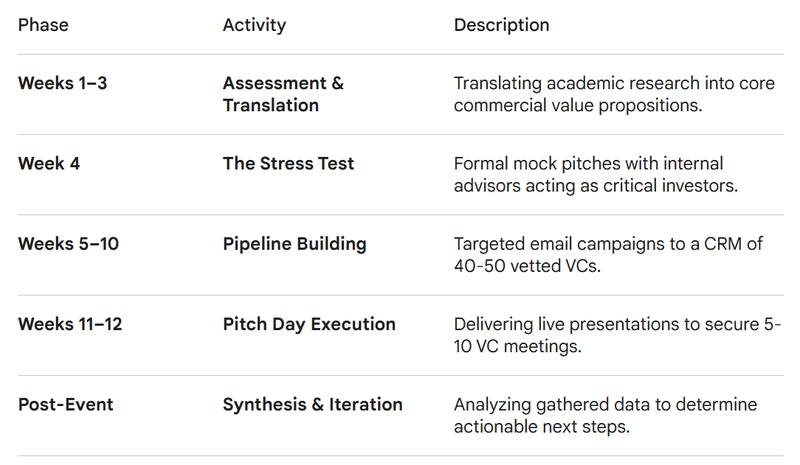

Slide 10
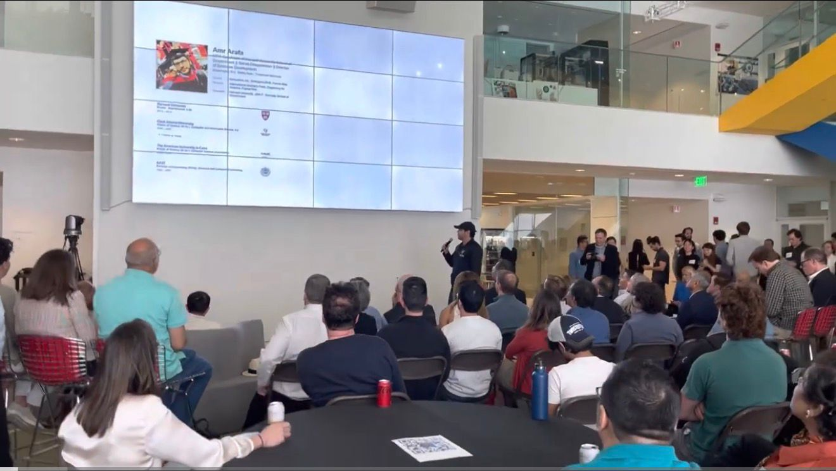
Pitch Day Example (MIT MAS.665 AI Venture Studio)

